Slide 1
Quivers and 2D Regression
Keshav Shivam

Slide 2
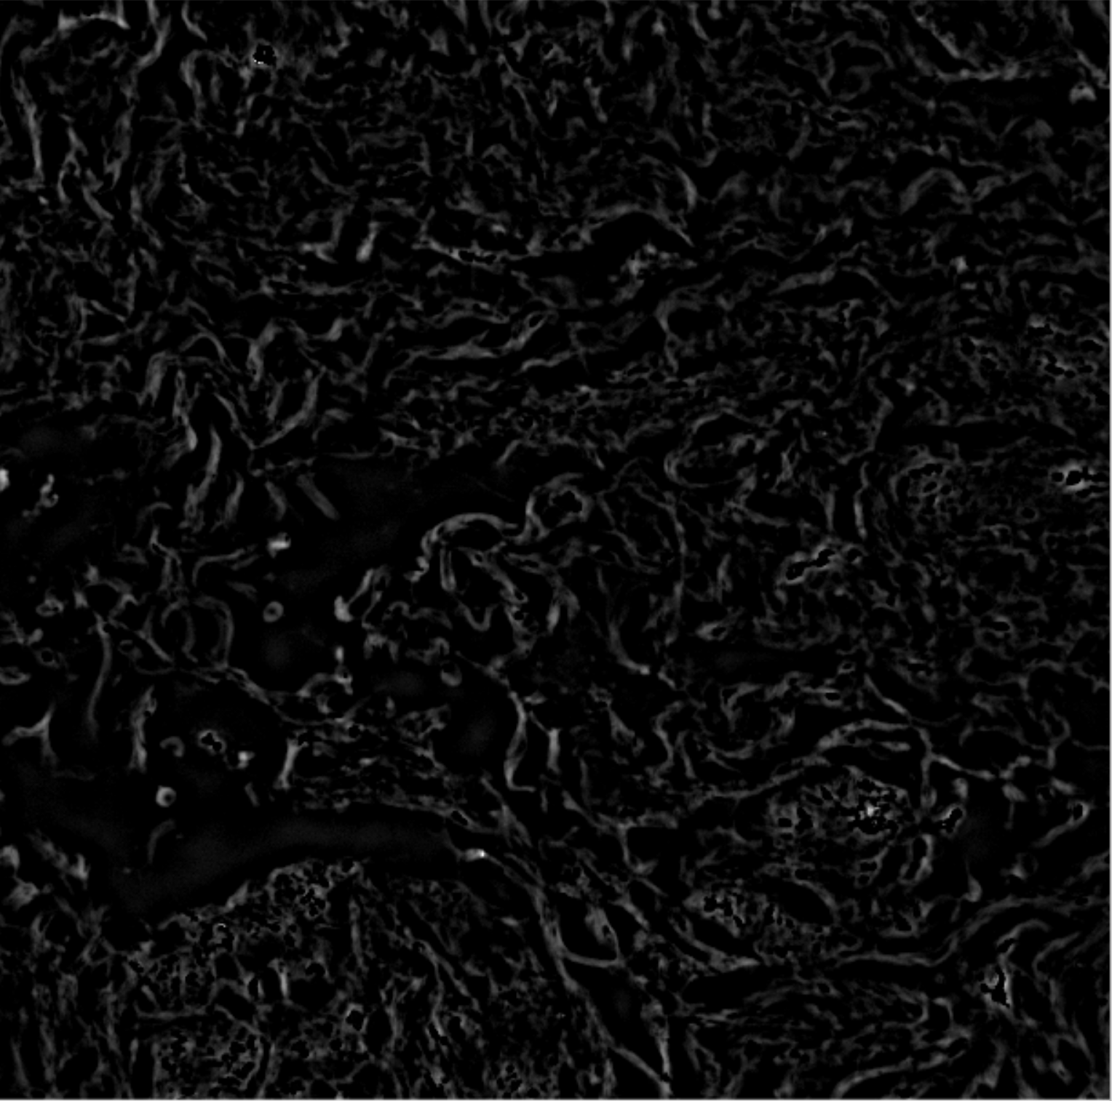
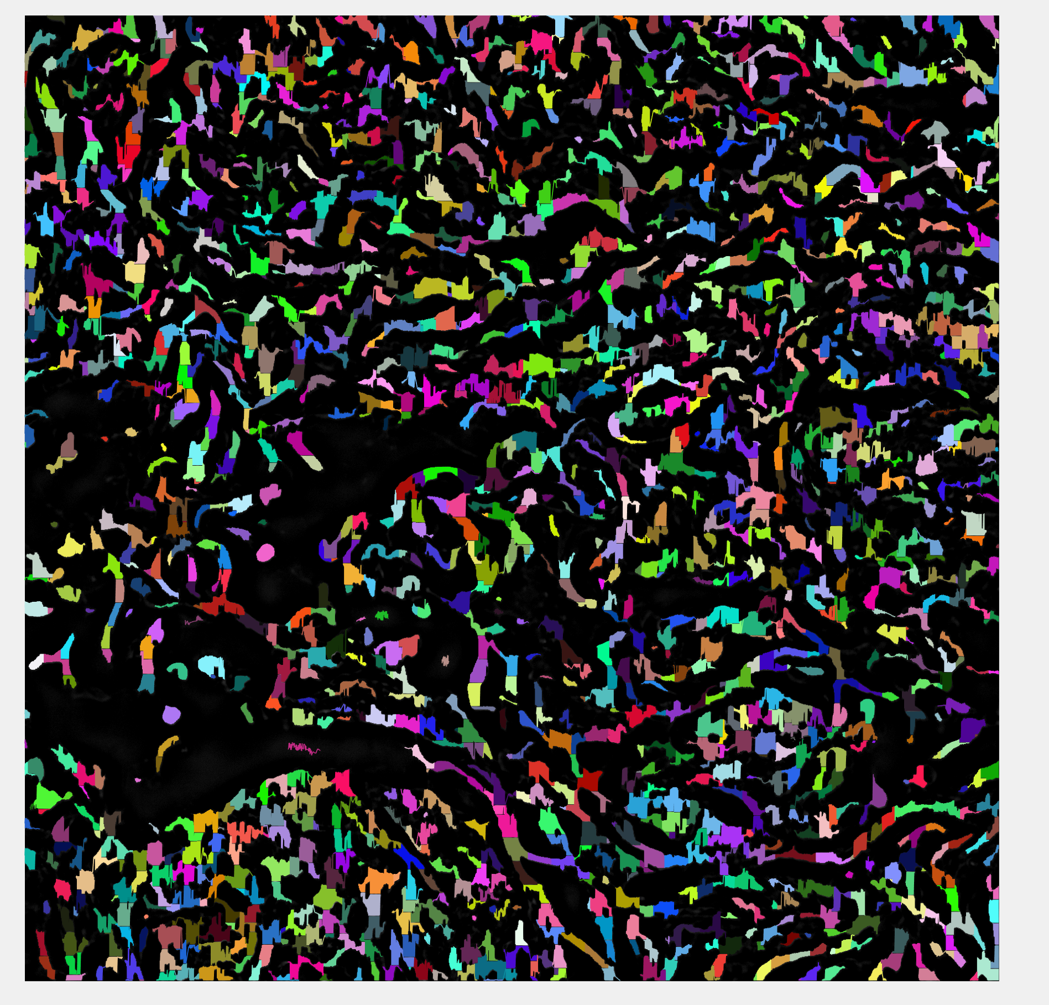
Ran in ~3 hrs, left it on overnight
fibers = FiberFinder(1, rows, cols, imgArray, 0.05, 10, 2, 13, 0);
32,000 nucleation points were expanded

Slide 3
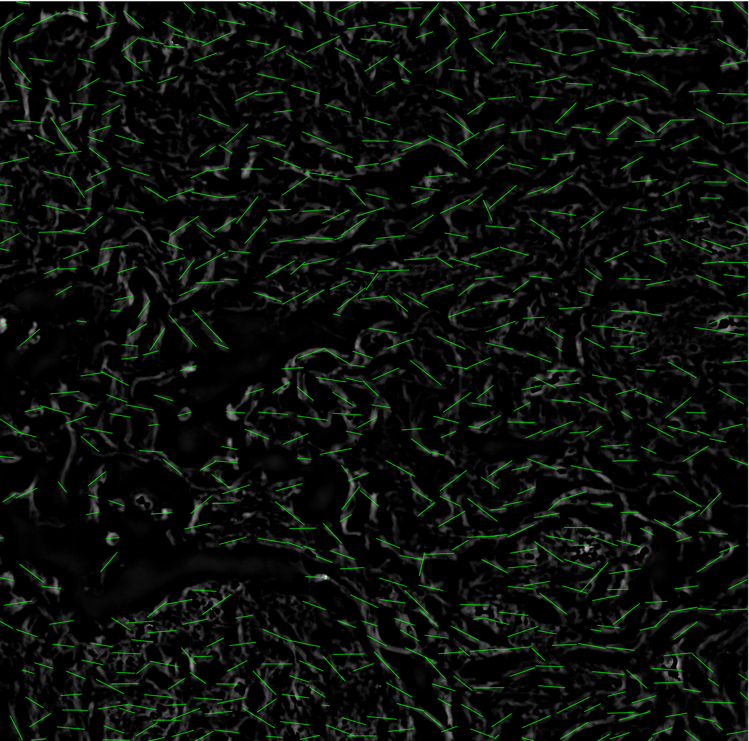
Performed linear regression to find line of best fit for each of the fibers
Ran in 30 min
fibers = FiberFinder(1, rows, cols, imgArray, 0.05, 10, 2, 13, 0);
50,000 nucleation points were expanded

